Slide 1

Thanksgiving Store
By
Manikanta Kethireddy
Nikhil Ravuri
Venkatesh Nidimokkala

Slide 2
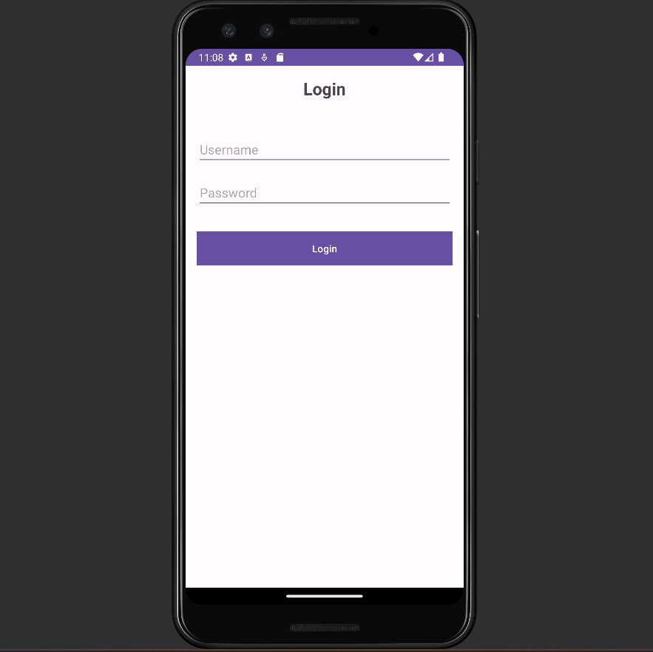
Login page
Here you can enter your login credentials

Slide 3
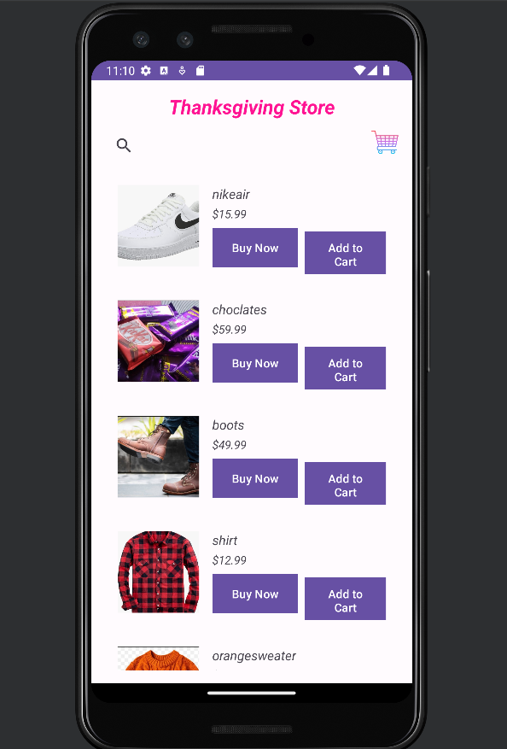
List of items
These are the items which are available in Thanksgiving Store

Slide 4
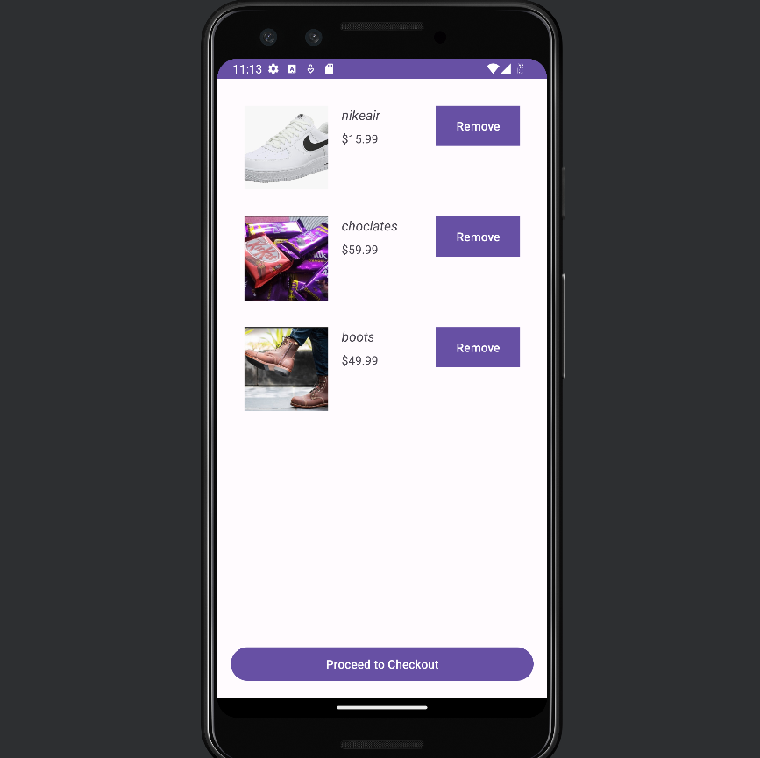
Add to cart
By clicking the add to card button you add the items to cart and if you click on proceed to checkout the product will be deliverd

Slide 5
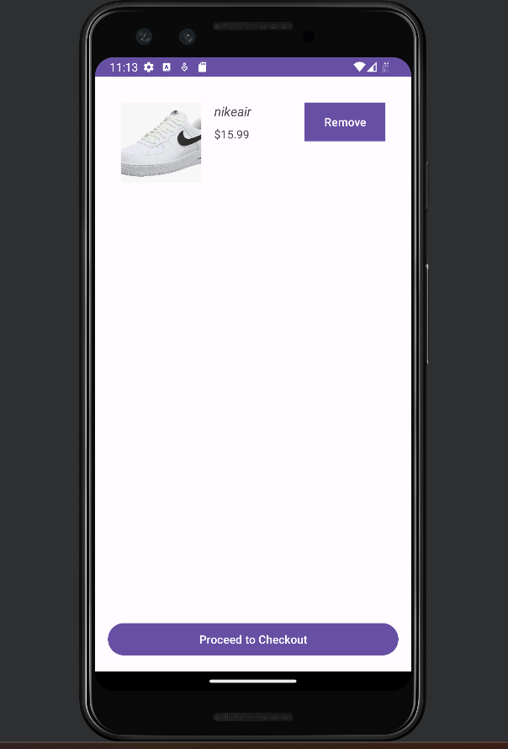
Remove button
By clicking on three remove button you can remove the products from the app.

Slide 6
Thank you

